Slide 1

Predicting Fuel Efficiency using Tensor Flow in Python
by:- Anish parhi - 2241016181
soumya ranjan behera - 2241002115
BAIVAB MISHRA - 2241013140
SPANDAN BEHERA - 2241002116
JEEBAN JYOTI ROUT - 2241018154
Department of Computer Science & Engineering Faculty of Engineering & Technology (ITER)Jagamohan Nagar, Jagamara, Bhubaneswar, Odisha - 751030

Slide 2
1.OBJECTIVE:-
Aim of the project:
Our main objective was to predict the vehicle’s fuel efficiency or the MPG(Miles per gallon).
Scope of the Project:
The scope of the project is to develop a Machine Learning Model that gives better attributes i.e., properties of a vehicle for fuel efficiency.

Slide 3
2.INTRODUCTION:-
The automotive industry which is extremely competitive.
With increase fuel prices and picky consumers, automobile makers are constantly optimizing their processes to increase fuel efficiency.
But, what if you could have a reliable estimator for a car’s mpg given some known specifications about the vehicle?
Then, you could beat a competitor to marker by both having a more desirable vehicle that is more efficient, reducing wasted costs and gaining large chunks of the market.
Utilizing machine learning, we build prediction model designed to give an edge over company competitor.

Slide 4
3.LITERATURE SURVEY:-
Strengths:
Flexibility & Scalability: TensorFlow offers a versatile platform for handling large datasets and complex models, ideal for fuel efficiency research.
Transfer Learning: TensorFlow supports transfer learning, enhancing model performance and reducing training time by leveraging pre-trained models.
Limitations:
Data Availability & Quality: TensorFlow's performance relies heavily on the availability and quality of training data, posing challenges in fuel efficiency research due to limited and unlabeled datasets.
Overfitting & Generalization: Deep learning models in TensorFlow may suffer from overfitting, necessitating careful regularization and validation to ensure robustness and generalization.

Slide 5
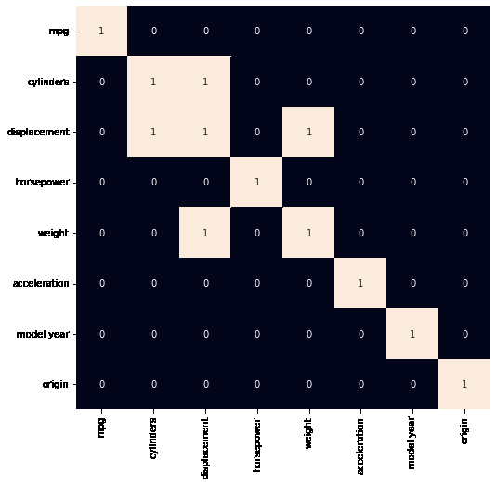
Potential Applications:
Vehicle Design Optimization: TensorFlow models optimize vehicle designs for better fuel efficiency by predicting effects of parameters like aerodynamics and powertrain.
Predictive Maintenance: Deep learning models analyze sensor data to predict and diagnose issues, enhancing fuel efficiency through proactive maintenance.

Slide 6
4.METHODOLOGY:-
Matplotlib: Python plotting library with static, interactive, and 3D visualization options.
Numpy: Efficient Python library for numerical operations on large arrays and matrices.
Pandas: Powerful Python library for data manipulation and analysis, excelling in handling tabular and labeled data.
Seaborn: High-level Python library for creating visually appealing statistical graphics, built on Matplotlib.
TensorFlow: Google's open-source library for building deep neural networks with Python, offering APIs for training and deploying ML models.

Slide 7
IMPLEMENTATION:-
Data Collection and Preprocessing: We load the data from a CSV file, handle missing values, and one-hot encode categorical features using pandas.
Feature Engineering: We define the numerical and categorical input features, and create input tensors for each feature using Keras functional API.
Model Architecture Selection: We define a Feedforward Neural Network architecture using Keras functional API, with Dense layers, Dropout, and Concatenate layers.
Model Training: We compile the model with the mean squared error loss and Adam optimizer, and train the model using the fit() method with early stopping callback.
Model Evaluation and Tuning: We evaluate the model's performance on the test set using mean absolute error (MAE) metric. We also use the ELI5 library to interpret the model's predictions and analyze the importance of different input features using permutation importance.
Model Deployment and Integration: We save the trained model to an HDF5 file for deployment.
Continuous Improvement: We include a comment indicating the need for monitoring and retraining the model with new data for continuous improvement.

Slide 8
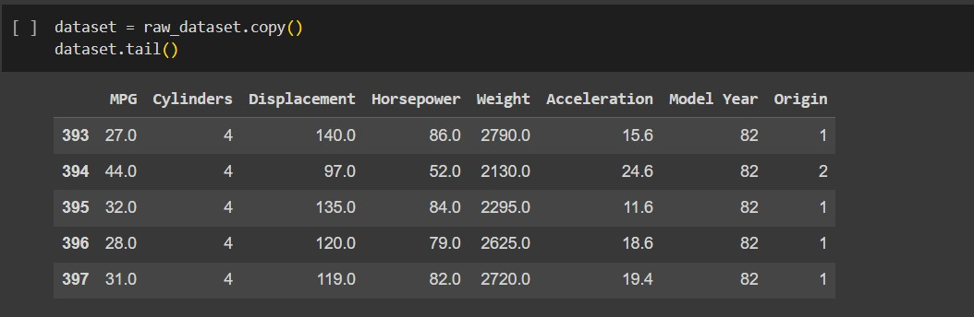
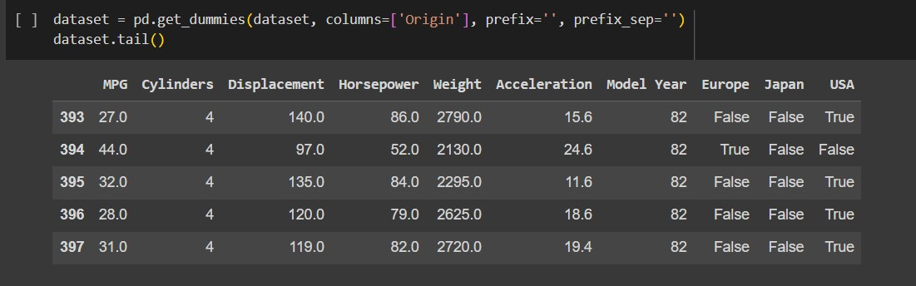
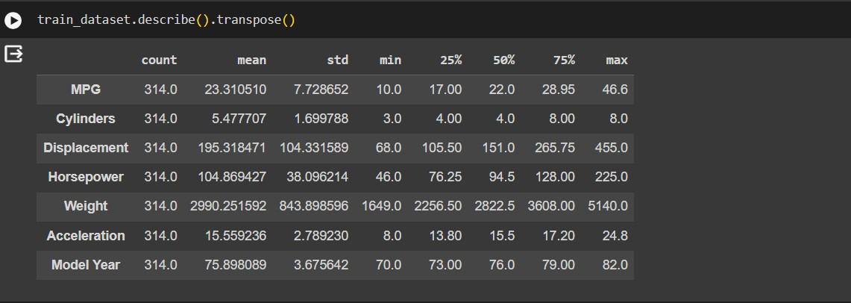

Slide 9
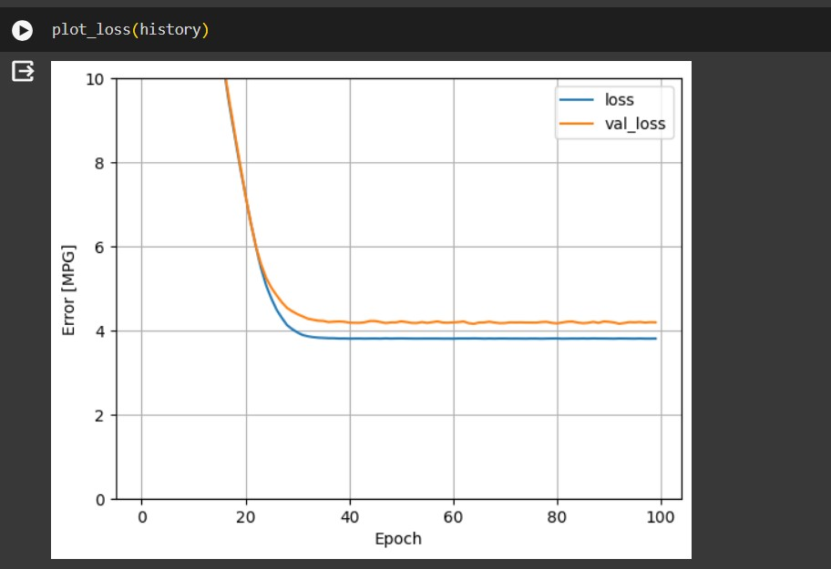
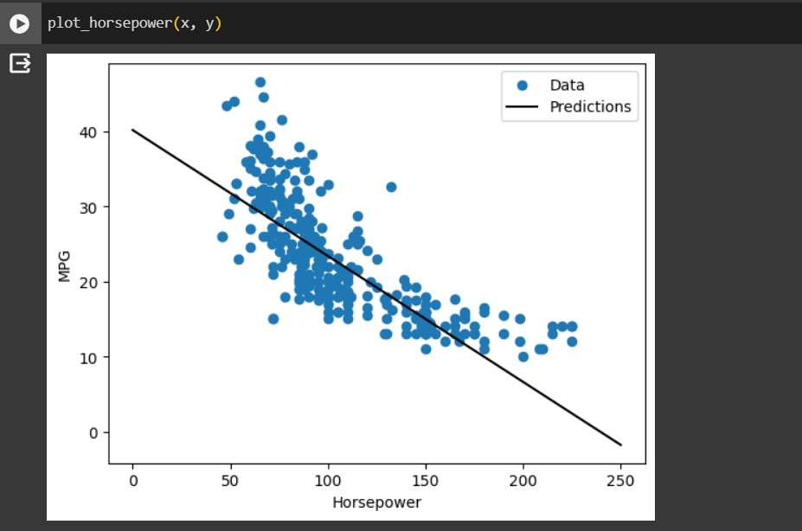
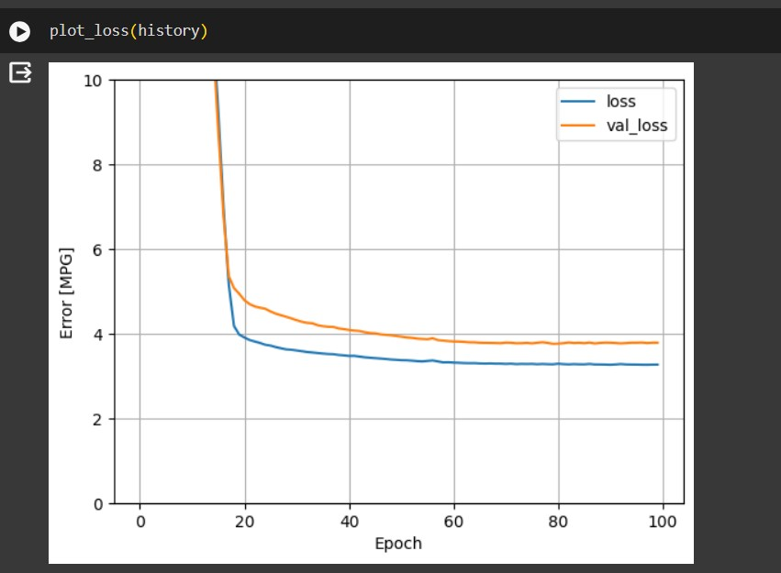
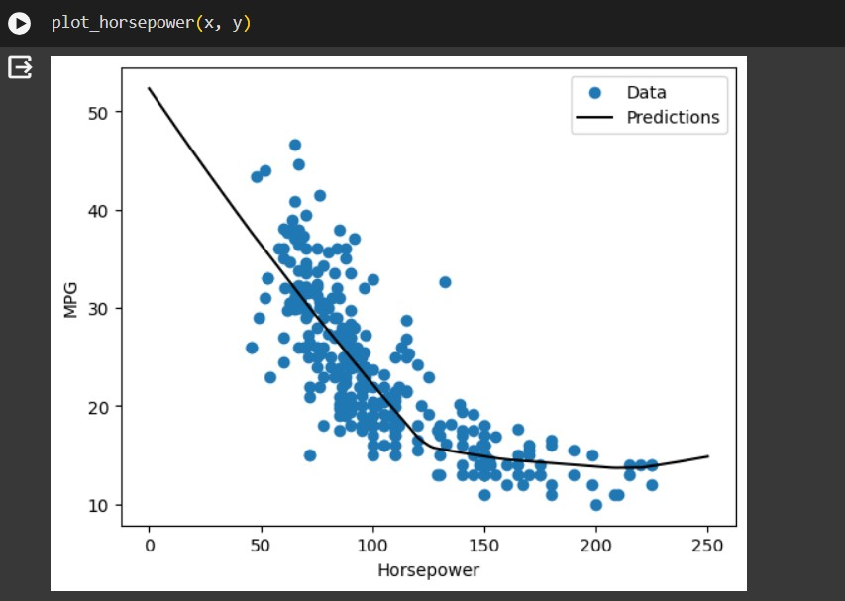
5.results

Slide 10
6.CONCLUSION:-
Fuel prices are increasing rapidly each day, and the demand of vehicles with better fuel efficiency or Miles per gallon is growing tremendously.
During this project, our main objective was to predict the vehicle’s fuel efficiency or the MPG(Miles per gallon). We have done the data preprocessing to make the dataset free from null values and other disturbances, then we performed data visualization of the data represent and know well about the attributes in the dataset.
We have implemented various machine learning models and checked for their errors and accuracies until we get the best effective model for the data taken.
Fuel-efficient cars emit less pollution over the same amount of distance traveled. They also cost less to operate. Buying a more fuel-efficient car can save you thousands of dollars on fuel costs over time and can often balance out a higher purchase prices if you keep the car long enough.

Slide 11
REFERENCES:-
1.Allcot, H. (October 2009). “Social Norms and Energy Conservation.”
2. Prepared for the Center for Energy and Environmental Policy Research, Massachusetts Institute of Technology. Barkenbus, J. N. (2010).
3.“Eco-driving: An Overlooked Climate Change Initiative.” Energy Policy (38:2); pp. 762–769. Boriboonsomsin, K.; Vu, A.; Barth, M. (2010).
4. Eco-Driving: Pilot Evaluation of Driving Behavior Changes. Riverside, CA: College of Engineering—Center for Environmental Research and Technology, University of California Riverside.
5.Earleywine, M.; Gonder, J.; Markel, T.; Thornton, M. (September 2010). “Simulated Fuel Economy and Performance of Advanced Hybrid Electric and Plug-in Hybrid Electric Vehicles Using In-Use Travel Profiles.” Proceedings of the 6th IEEE Vehicle Power and Propulsion Conference (VPPC). Lille, France.
6.Ehrhardt-Martinez, K. (April 2010). “Policy Innovations and People: Active Participants in the Energy Revolution.” Prepared for the ACEEE 30th Anniversary Symposium: Energy and the Economic Imperative, April 2010. Washington, D.C.
7.SAE International. (September 2010). “Utility Factor Definitions for Plug-In Hybrid Electric Vehicles Using Travel Survey Data.” Surface Vehicle Information Report SAE J2841.

Slide 12
SPECIAL THANKS TO MR SHIVA AGARWAL SIR.
THANK
YOU

